Slide 1
Python for Data Analysts
Morgan McKnight

Slide 2
What I will be covering ~ tonight
What is Python and why is it so popular?
What are Jupyter Notebooks and who uses them?
Examples of Jupyter Notebooks (Fintech, Covid, property_prices)
Creating a Jupyter Notebook
Create Hello World.
Data Analysis of house prices in Dublin
Python for Data Analysts, Diploma course

Slide 3
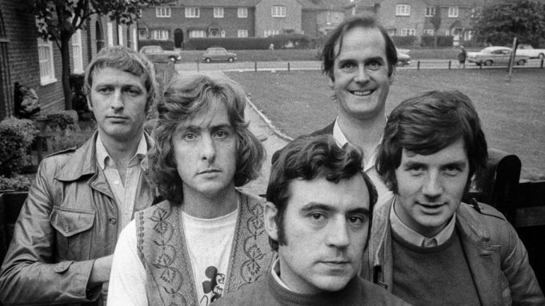
Python Philosophy
Simple is better than complex.
Beautiful is better than ugly.
Explicit is better than implicit.
Complex is better than complicated
Readability Counts

Slide 4
Who uses in Python?
Instagram is built in Python.
It is one of the three official languages used by Google engineers.
Netflix uses Python to power its data analysis on the server side.
Dropbox uses Python for its desktop client.
Reddit is coded in Python.

Slide 5

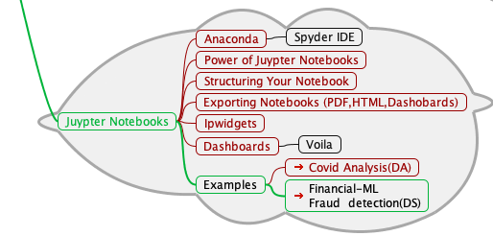
Introduction

Slide 6
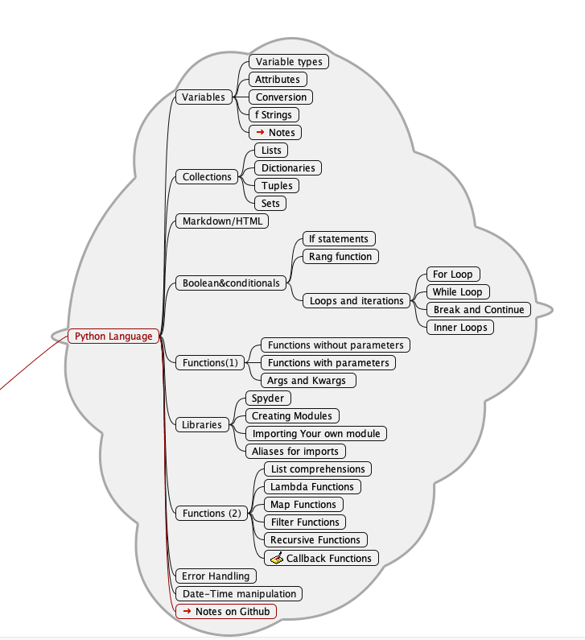

Course Outline (1)

Slide 7
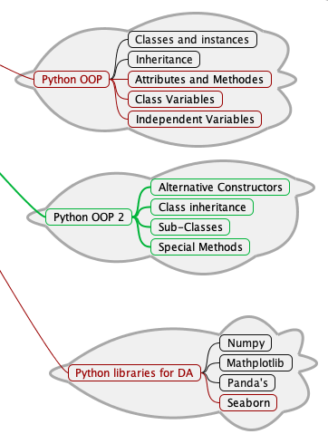

Course Outline (2)

Slide 8
File Structure
Images (.png, jpg, etc.)
Juypter Notebooks (.ipynb)
Data (.csv )
Python Lesson 1 - Hello World.ipynb
Python Lesson 1 - Hello World.ipynb
Modules(.py )

Slide 9
Assignments
Assignment 1 (week 6)
Assignment 2 (week 11)
To create a program with two turtles that draw on the screen and interact with each other. (You are free to interpret this as you like.)
To either download a dataset from the internet e.g. weather data, or use suitable data from your workplace, and using Python, Pandas and Matplotlib, analyze the data and display the results in a table and graph.
(You should have some statistical calculations such as mean, max min in your analyses )

Slide 10
Rules of Engagement
Class Etiquette
Assignments
Log in with your IBAT Gmail.
Keep your camera on
Keep your mike off
Keep your socks up
Ask a question at any time
If you do not understand, ask me to go back/slow down.
Do not look at solutions before attempting the SAQs
Get them in (no matter how bad)
Your assignment can be as big or as small as you like.
Do not worry or miss classes if you are struggling.

Slide 11
How to get the most from this course
Try to attend all classes
Spend a minimum of 30 mins each week revising.
A drop-in clinic will be run every Wednesday @ 7pm. Come along if you have a question/problem or if you are struggling with content.
You will at times have to suspend understanding, but trust me, you will learn through repetition and familiarity.
I hate losing students. The main reasons are:
Falling behind
Missing Classes (Work Late)
Laziness

Slide 12
Mob Programming
The teaching strategy I will be using is a problem-based approach.
At the start of a lesson, you will be presented with a problem; at the end of the lesson, you will be divided into groups to solve the problem.
I will nominate a facilitator in each group whose roll will be to document the solution. Everybody should participate; everyone should understand the solution.
As an experiment for this course, we will be using Deepnotes for our solutions. Make sure you are signed up and signed into deep notes.

Slide 13
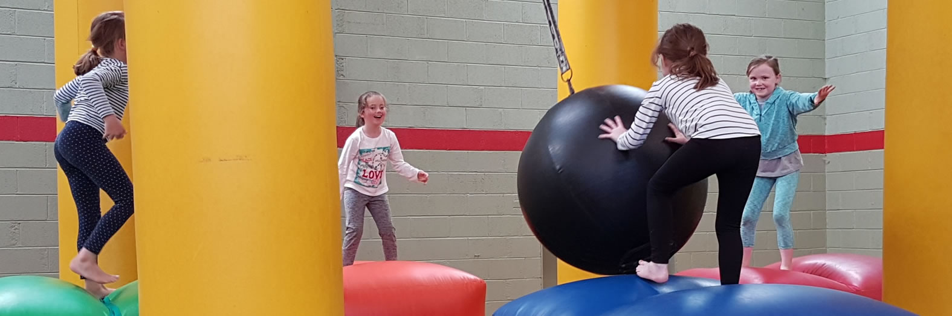
Let’s Go!

